Slide 1
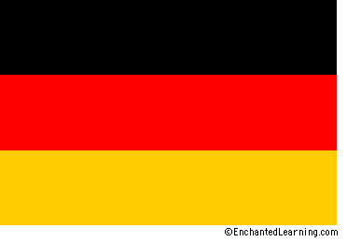
Germany
By: Connor Wielt, Isabelle Smith, Phoebe Roache, and Benjamin Weinzapfel

Slide 2
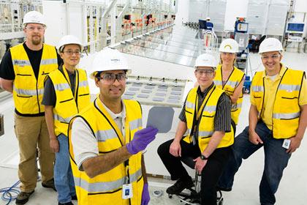
Jobs
The most common job in Germany is agriculture but it is declining. Agriculture is Germany has declined in importance since the 20th Century and by 1989 only amounted to 1.6 % of the West German GDP. There are other jobs such as factory work and tourism work such as working in resturants and hotels.

Slide 3
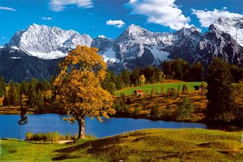
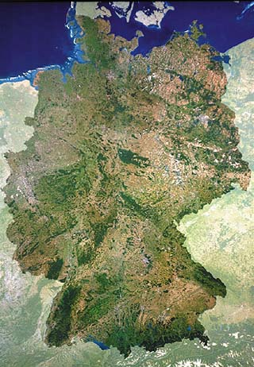
Terrain
Germany's terrain has many mountains and high hills, but also has plains and low places too.Germany has big lakes and a lot of trees. Overall Germany is a cool and cold place to be. People have to where heavy clothing and wear coats.There is a lot of snow in many places in Germany

Slide 4
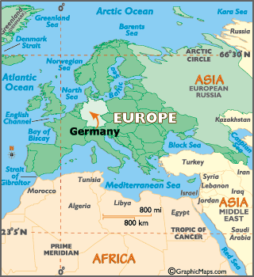
Longitude and Latitude
The coordinates of Germany are 51 N, 9 E

Slide 5
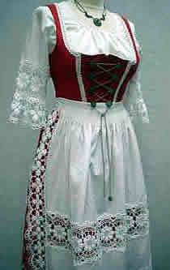
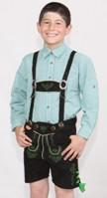
Apparel and Clothing
Many Germans dress very similar to every other Western country, where clothing style is determined by age, job, and personal taste. Most styles are similar to tourist from other countries. They like lederhosen!!!! And girdles!!!!

Slide 6
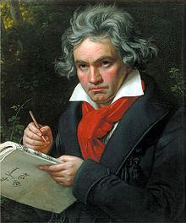
Music
Forms of German music include Neue Deutsche Welle (NDW), Krautrock, Hamburger Schule, Volksmusik, Classical, German hip hop, trance, Schlager, Neue Deutsche Harte (NDH) and diverse varieties of folk music, such as Waltz and Medieval metal.
German Classical is among the most performed in the world; German composers include some of the most accomplished and popular in history, among them Johann Sebastian Bach, Ludwig van Beethoven, Franz Schubert, Johannes Brahms, and Richard Wagner. Wolfgang Amadeus Mozart, born in Salzburg (now in Austria), was among many opera composers who created the field of German opera.
The beginning of what is now considered German music could be traced back to the 12th century compositions of mystic abbess Hildegard of Bingen, who wrote a variety of hymns and other kinds of Christian music.

Slide 7
Food
Breakfast in Germany is pretty much just like ours on school days they eat cereal and go for a more traditional meal on the weekends of eggs with coffee or hot tea.
Lunch: They eat between 12 p.m and 2p.m. Some of the meals they eat include roast pork and a dumpling, pancakes, or roast and noodles.
Dinner:Pork, Meat, and poultry dishes are the favorite main courses at dinner. They are eaten with bread, cheeses, and a warm drink.
Desserts: one popular dessert is Beesting cake it is made of a sweet cake with a baked on topping of honeyed almonds or walnuts.
The food they eat affects geography because depending on if the food is good or bad for you it affects if people are fat or skinny. that affects how people have to make clothes and what is on the news(because they always talk about people being to fat on the news)

Slide 8
Art
German art has a long and distinguished tradition in the visual arts, from the earliest known work of figurative art to its current output of contemporary art.
Germany has only been united into a single state since 20th Century and defining its borders has been a notoriously difficult and painful process. For earlier periods German art often effectively includes that produced in German-speaking regions including Austria, Alsace and much of Switzerland, as well as largely German-speaking cities or regions to the east of the modern German borders.

Slide 9
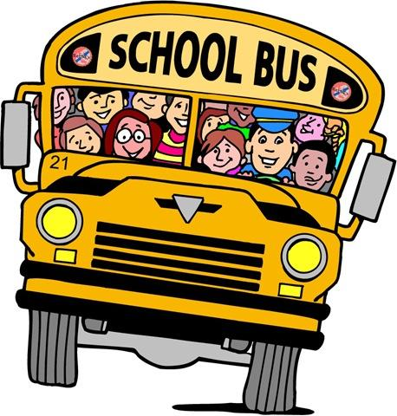
Education
Education in Germany is public, i.e. most schools, colleges and universities are paid for by the taxpayers and therefore do not charge tuition. There are no local school or college boards and no PTA's, although parent-teacher conferences take place regularly.Educational programs are organized, financed and administered at the state level.The Department of Education in each of the 16 federal state oversees the state's primary, secondary and career training schools and much of higher education.A framework for post-secondary education is set up at the federal level. Administrators at both the state and federal level cordinate educational planning and research. As a result the standard of teaching and testing is relatively equal throughout the country, although curricula may vary from state to state.

Slide 10
History
Throughout Germany's long history, it has rarely been united. In 800 A.D. the Holy Roman Emperor gained control of Belgium, France, Germany, the Netherlands, and Switzerland. But by one generation, its existence was more symbolic than real. In the first half of the 20th century, Germany had been majorly involved in both World Wars which left it full of Allied Powers. After the Cold War, Germany split up into East Germany and West Germany. East Germany was a democratic republic while West Germany was a democracy.

Slide 11
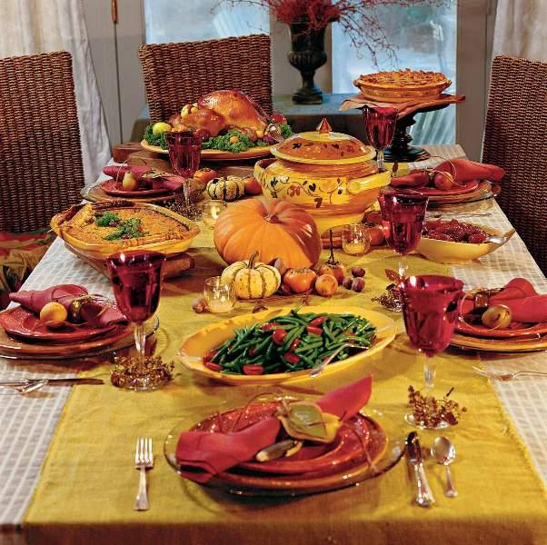
Holidays
They all celebrate the same Holidays as we do but here are some that are weird to us.
Epiphany-a Christian festival, observed on January 6, commemorating the manifestation of Christ to the gentiles in the persons of the Magi; Twelfth-day.
Assumption Day-The Feast of the Assumption of Mary is an occasion for Catholics to honor the belief that God assumed the Virgin Mary to heaven. It is a public holiday in some parts of Germany on August 15 each year.
Penanace Day-is a legal holiday in the following provinces of germany:Saxon

Slide 12
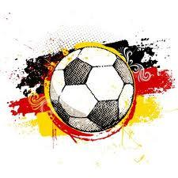
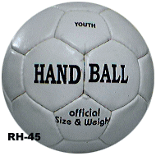
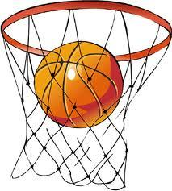
Sports
The most common sport is Football (soccer) They also play lots of other sports they include: handball, tennis, gymnastics, water sports, ice hockey, basketball and many more.

